Slide 1

A Better Life
time
Jonathan Michelin

Slide 2









macro
Universe
big bang
formation
life
?
Consciousness
frozen
aware
egoic
awake
Experience
past
future
micro
present
Frame
Regardless of our timeline, experience occurs now.
Notes:
Time is a map. It helps us see where we’ve been, where we are, and where we might go. It shapes who we are.
Let’s look at the universe’s timeline: First, nothing. Then—BOOM! The Big Bang. Stars, planets, and eventually, life on Earth.
Now we zoom in on the timeline of consciousness: A potato just exists. Animals are aware but not lost in thought. Then humans arrived. We became self-aware, worrying about the past and future, losing touch with the present.
Now even deeper, we can look at our individual timeline: We live endowed with memories and plans, but life experience only happens now. The past and future are stories in the mind

Slide 3
Life Satisfaction
We can evaluate experience through self-reported “life satisfaction”
How we change may change our life satisfaction
Things we can’t change may change our life satisfaction too
Δ Environment
Δ Money
Δ Health
Δ Perspective
Ethnicity
Δ Traits
Δ Age
Δ Relationships
Notes:
Our individual experiences can be captured at different present moments using a measure of self-reported “life satisfaction” (i.e. asking “how satisfied are you with your current life situation?”).
We can hypothesize that how we change over time may change our life satisfaction as a result. We can also hypothesize that factors out of our control may affect our life satisfaction as well. The distinction between these two can be a psychological nuance of agency, so the lines are not drawn. Changes in your income, relationships, personality, perspective, health and other things are all potential determinants to be examined.

Slide 4

Data
MIDUS: a national longitudinal study on health and well-being:
Source:
https://midus.colectica.org/
Launched: 1995
# people: 12,000+
# valiables: 2000+
Midus 1
Midus 2
Year=1996
#=7000
Fields=2000
Year=2025
#=6200
Fields=254
Year=2005
#=7000
Fields=2000
Data Cleaning (pd.merge, fillna etc)
Notes:
Thankfully, there is a shared database offered by the university of michigan called the MIDUS project. It surveys multiple individuals and follows up over their lifetime so we can measure changes in their health and socio-psychological situations and perceptions over time. The data is challenging to extract, clean, join, and normalize, but once cleaned, I was left with a joined dataset, curated with 254 variables to explore - life satisfaction being 1 of them

Slide 5








TL;DR
1
Research Question:
What factors influence life satisfaction the most?
Perspective/Personality: Feeling more creative, assertive, open-minded, and sympathetic
Data:
MIDUS longitudinal study on health and well-being
Model:
Logistic Regression
Agency + Gratitude: Feeling in control over life and feeling grateful to be alive
2
Interactions: Improved positive relationships, mastery of living environment*, productivity under stress
3
Results:
The following are associated with improved life satisfaction:
Health: Improved physical health, relief letting go of responsibilities
Personality + Perspective
Agency +
Gratitude
Relationships + Environment
Health
Practice being present (shift attention from mind)
Notes:
In case you’d like to tune out for the rest of the journey, I’m serving the results right away.
So, Improvements in life satisfaction over a 9 year period is associated with 4 categories of results:
Personality: feeling more creative, more assertive, more open-minded and more sympathetic
Agency and gratitude: as author and psychiatrist Dr. Paul Conti has already shown, agency and gratitude are important aspects of improved life satisfaction, specifically, my model shows that feeling more grateful for being alive and feeling an increased amount of control over your life are two important factors
Improvements in positive relationships, mastery of ones environment, and productivity under stress are also statistically significant determinants of life satisfaction
Lastly, improved physical health, more meaning in one’s responsibilities leads to a more satisfying life.

Slide 6
Journey

Slide 7
Scope
Step | Details
Exploratory Analysis | Correlation matrix, histograms, summary stats
Hypotheses | What may improve life satisfaction?
Models | Logit, Random Forest
Conclusion | What can we say?
Notes:
Now I’m going to speed through these slides, but I will post them on linkedin and eventually github if you want to look in more depth. I explored the data, guessed some things, tried some models on python, and made conclusions

Slide 8
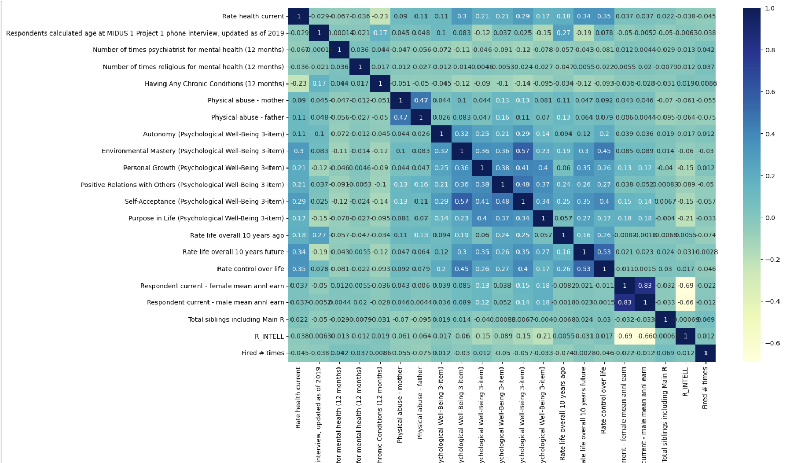
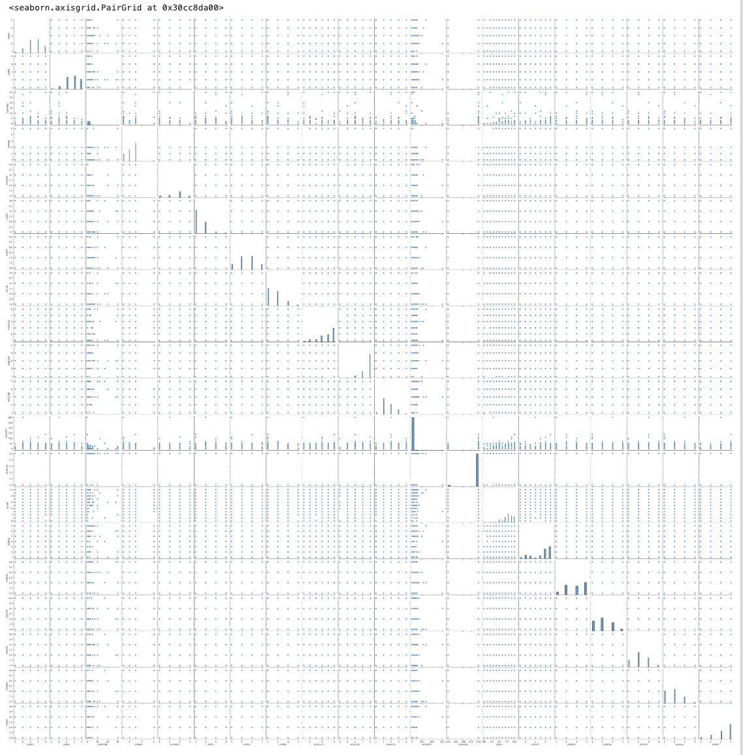
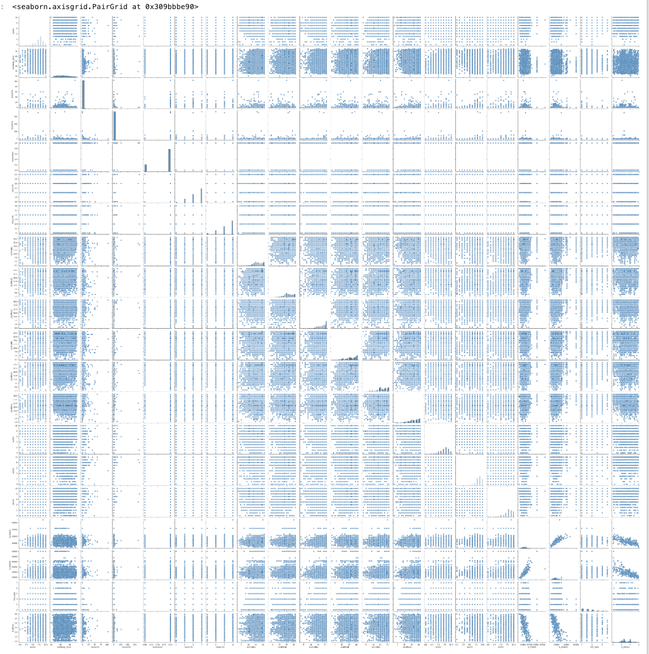
Exploratory Analysis: Control over life
“Control over life” changes with current health (r=0.35) and environmental mastery (r=0.43)
High positively correlated relationships (r) :
(0.57) Self-acceptance ←→ Environmental Mastery
(0.43) Control over life ←→ Environmental Mastery
(0.35) Current health ←→ Control over life
(0.83) Female income ←→ Male income (in same household)
sns.heatmap(df.corr(numeric_only=True))
sns.pairplot(df[[field_list]])
Notes:
In exploring the data, I created pairplots, and correlation matrices to find that control over life moves with health and environmental mastery. Other interesting correlations were found

Slide 9

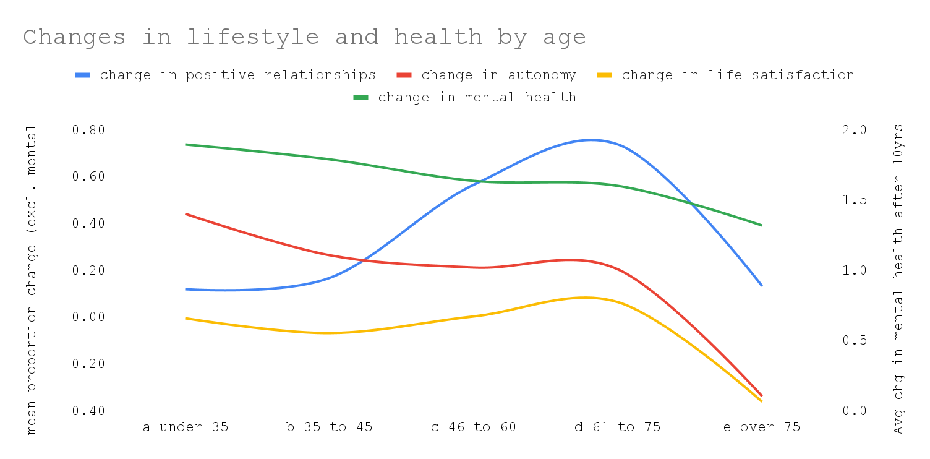
Exploratory Analysis: Age & Life
Age: <35 to 45
Highest growth in autonomy and mental health
Positive relationships tends to improve over time until the age of 75
Mental health growth remains positive at a decreasing rate
After 35, average changes in autonomy decrease
Age: 45-60
Positive relationships incline
Age: 61-75
Highest life satisfaction & positive relationships
Age: 76+
Largest decline in health, relationships, and autonomy
Notes:
Pivoting the data by age categories, we can see the trend life satisfaction, relationships, autonomy, and mental health. Looks like the peak average improvements in life satisfaction and positive relationships is between ages 61 and 75, so we all have something to look forward to.

Slide 10
Hypotheses
# | Hypothesis
1 | More income is positively associated with life satisfaction
2 | Improved health (physical & mental) is positively associated with improved life satisfaction
3 | Increased gratitude and agency is positively associated with improved life satisfaction
4 | Increased assertiveness is positively associated with improved life satisfaction
5 | Increased creativity is positively associated with improved life satisfaction
6 | Improved open-mindedness is positively associated with improved life satisfaction
7 | Improved calm is positively associated with improved life satisfaction
Notes:
There are a lot hypotheses, but I won’t go through these

Slide 11

Model: Approach
CLEAN + TRANSFORM
MIDUS 1
MIDUS 2
Model A = Logit
Model B = Random Forest
1996
2005
2005
1996
Money
Money
Δ Money
Perspective
Perspective
Δ Perspective
Features
Traits
Traits
Δ Traits
Health
Health
Δ Health
Ethnicity
Ethnicity
Ethnicity
Age
Age
Δ Age
Other
Other
Δ Other
(A)
Life Satisfaction
(B)
Life Satisfaction
Δ (B minus A) Life Satisfaction
Target
Notes:
The model approach took the difference in individual’s responses from 2005 minus their 1996 responses, one-hot encoding positive vs negative changes in life satisfaction as the model target, and using changes in socio-phycological factors and the model features. I attempted a random forest, but the explanatory variable impact were challenging to interpret. A logistic regression was the second model used because it is easily interpretable

Slide 12
Model
Target
Features: Δ = change
[2005 responses minus 1996 responses]
Δ Money
male/female income, became entrepreneur
Δ Life Satisfaction*
Δ Perspective
gratitude, agency, willpower, goals, growth…
Δ Traits
creativity, assertiveness, calm, sympathy…
“How Satisfied are you with your life?”
10: very satisfied
1: not satisfied
Δ Health
physical health, mental health
*Has life satisfaction improved?
(if 2005 response minus 1996 response > 0 then 1 else 0)
Ethnicity
ethnicity
Δ Age
age bucket
Δ Other
relationships, env. mastery, productivity…
Notes:
Here are the specifics

Slide 13
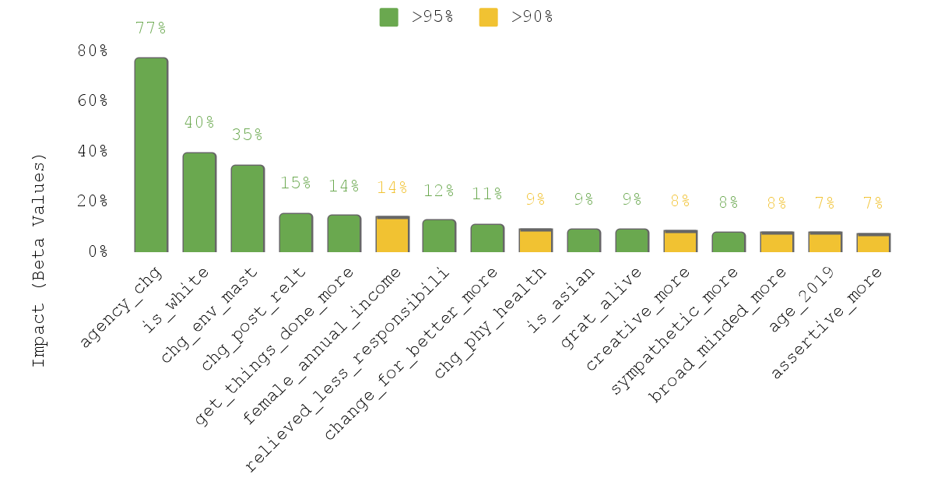
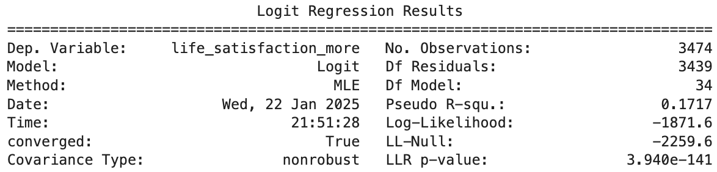
Model: Output
Impacts
Evaluation
Type: logistic regression
Package: sklearn
Eval: accuracy, recall, f1, p-value, pseudo R²
Accuracy: 71%
Recall: 45%
F1-Score: 53%
ROC-AUC Score: 0.7505
Confusion Matrix:
[815 141]
[292 241]
Notes:
The output shows a 71% accuracy, 53% F1 score, ROC-AUC score of 0.75 and a pseudo r-squared of 0.17. This means that everything in the model only explains around 1 fifth of the likelihood of experiencing a positive change in life satisfaction over a 9 year period.

Slide 14
time
Model: Impacts
% chance of improved life satisfaction in next 10 yrs
+13%** more agency
77% chance Life Satisfaction will improve
is white
40%
+6% environment mastery
35%
+6% positive relationships
15%
>+0 completing tasks under stress
14%
Improved Life Satisfaction
>+0 tries to change for the better
11%
>+0 relief from less responsibilities
12%
+20% better physical health
9%
is asian
9%
+16% in gratitude for feeling alive
9%
>+0 more sympathetic
8%
>+0 more creative
8%
+1 year age
7%
>+0 open mindedness
7%
>+0 assertiveness
7%
95% confidence
90% confidence
**Improvements based 1 unit improvement in mean (1/improvement % = mean)
Notes:
Looking at the top drivers, feeling control over your life, being white, having control over your environment, and improving positive relationships all have double digit probabilities of improved life satisfaction.

Slide 15
Conclusion: Insights
The following is associated with improved life satisfaction:
Perspective: Feeling more creative, assertive, open-minded, and sympathetic
Agency + Gratitude: Feeling in control over life and feeling grateful to be alive
Interactions: Improved positive relationships, mastery of living environment*, productivity under stress
Health: Improved physical health, mental health: relief from letting go of responsibilities
Perspective/Personality
Agency + Gratitude
Interactions
(with self + others)
Health
Creative
Assertive
Open Minded
Sympathetic
Grateful for life
Control over life
Positive relationships
Environmental Mastery
Productive under stress
Physically healthy
Relief from less responsibilities
*b. “In general, I feel I am in charge of the situation in which I live.” (R) h. “The demands of everyday life often get me down.” t. “I am quite good at managing the many responsibilities of my daily life.” (R)
Notes:
Here are the conclusions reiterated

Slide 16
Conclusion: What can we say?
Personality + Perspective
Agency +
Gratitude
Relationships + Environment
Health
# | Hypothesis | Conclusion
1 | More income is positively associated with life satisfaction | Failed to detect
2 | Improved health (physical & mental) is positively associated with life satisfaction | Physical health was statistically significant
3 | Increased gratitude and agency is positively associated with life satisfaction | Correct
4 | Increased assertiveness is positively associated with life satisfaction | Correct
5 | Increased creativity is positively associated with life satisfaction | Correct
6 | Improved open-mindedness is positively associated with life satisfaction | Correct
7 | Improved calm is positively associated with life satisfaction | Failed to detect
Notes:
And the hypotheses evaluated, with the most surprising being that income and “calmness” was not found to be significant drivers of improved life satisfaction

Slide 17
Appendix

Slide 18
Github
Python notebooks and cleaned data available on github:
https://github.com/jonathanmichelin1/projects/tree/main/research/life_satisfaction

